Slide 1
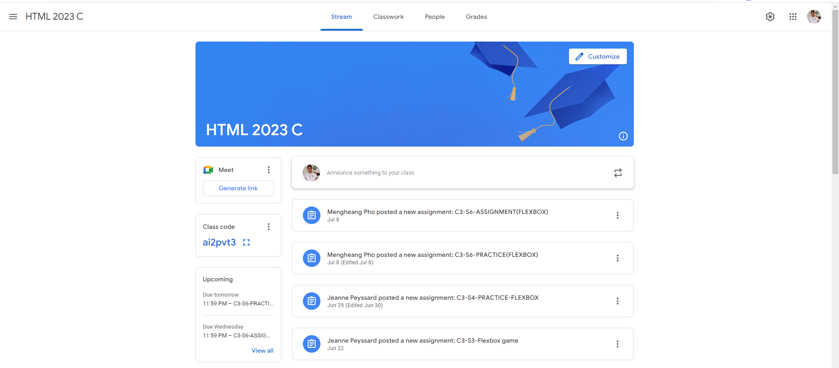
Identify root components of website below

Slide 2
Flex: 1;
Flex: 2;
Flex: 3;

Slide 3
Menu | Navigation
Flex 1
Flex 1
Flex 1
Nav-left
Nav-center
Nav-right

Slide 4
Menu | Navigation
icon
logo
button
button
Button
button
icon
icon
logo
display: flex;
justify-content : flex-start;
Align-items : center
display: flex;
justify-content : space-evenly;
Align-items : center
display: flex;
justify-content : flex-end;
Align-items : center

Slide 5
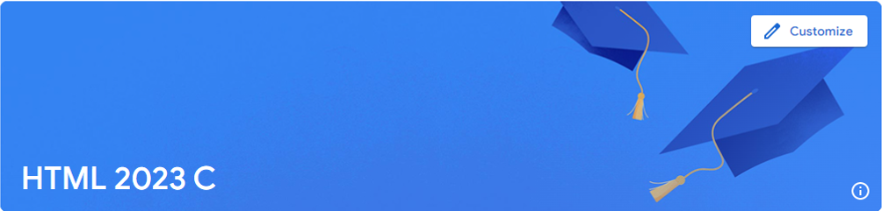
Header
Nav-top
Nav-bottom
display: flex;
Flex-direction: column;
justify-content : space-between;

Slide 6
Header
button
icon
display: flex;
justify-content : flex-end;
logo
icon
display: flex;
justify-content : space-between;

Slide 7
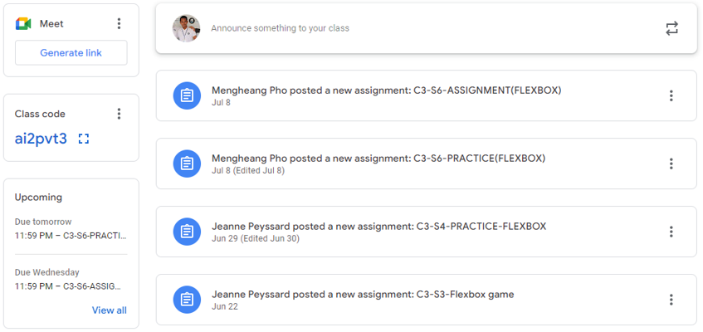
Main | Container

Slide 8
Main | Container
flex: 1;
flex: 4;
Main left
Main right
display: flex;

Slide 9
Main | Container
Card 1
Head card
display: flex;
Flex-direction: column;
justify-content : space-around;
Content card 1
display: flex;
Flex-direction: column;
justify-content : center;
Card 2
Content card 2
Card 3
Content card 3
Content card 4

Slide 10
Main | Container(main left)
logo
icon
Card 1
button
Card 2
logo
icon
button
Card 3
logo
button
button
button

Slide 11
Main | Container(main right)
logo
icon
Head card
Content card 1
content
Content card 2
logo
icon
Content card 3
Button
Content card 4

